Slide 1
User Experience Assessment of Vacuum Cleaning Robot
A study using Likert Scale and Rating Scale questionnaires

Slide 2
Introduction
This study evaluates users' experience with a vacuum cleaning robot using two questionnaire types:
- Likert Scale: Agreement-based responses
- Rating Scale: Numerical ratings
Data was collected from five participants.

Slide 3
Likert Scale Questionnaire
1. The vacuum robot is easy to use.
2. The cleaning performance meets my expectations.
3. The robot effectively navigates obstacles.
4. The battery life is sufficient for my needs.
5. The robot is quiet during operation.
(Scale: Strongly Disagree - Disagree - Neutral - Agree - Strongly Agree)

Slide 4
Rating Scale Questionnaire
1. How easy is the vacuum robot to use? (1-5)
2. How satisfied are you with the cleaning performance? (1-5)
3. How well does the robot navigate obstacles? (1-5)
4. How would you rate the battery life? (1-5)
5. How would you rate the noise level? (1-5)

Slide 5
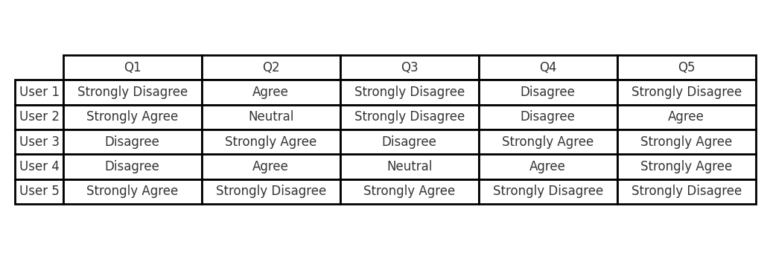
Likert Scale Responses

Slide 6
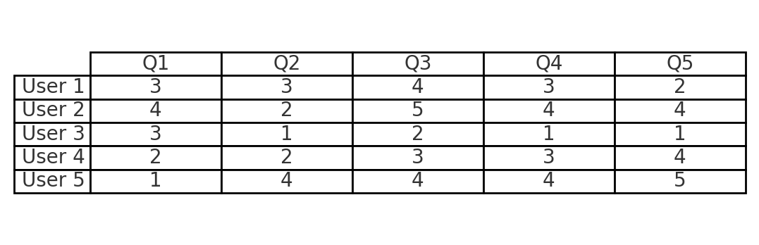
Rating Scale Responses

Slide 7
Results Analysis
Findings from the collected data:
- Users generally found the robot easy to use.
- Cleaning performance and battery life received mixed feedback.
- Navigation and noise levels had varied opinions.
Comparing Likert and Rating Scale:
- The Likert scale allowed more nuanced opinions.
- The rating scale provided clearer numerical insights.

Slide 8
Conclusion
Overall, users had a positive experience with the vacuum robot, but certain areas like navigation and battery life could be improved.
Both Likert and rating scales provided valuable insights:
- Likert scale captured detailed user sentiment.
- Rating scale allowed quick quantification of responses.
Future research could involve a larger sample size for more comprehensive results.

